Slide 1

Gas Leakage Detector
Department of Computer Science & Design
Company Name: Cranes Varsity
Domain: IOT And Detection Of Gas Leakage
Presented By:
Kusum Pakira
Shivani Adhikari
Arun A
Chandrasekar A
Purushotham V Mitti
Under the Guidance of:
Dr. Deepa S R, Head of Department, Computer Science & Design, KSIT
Dr. Surekha Byakod, Assistant Professor, Computer Science & Design Department, KSIT
-1KS21CG026
-1KS21CG042
-1KS22CG400
-1KS22CG401
-1KS22CG404

Slide 2
AGENDA
Company Profile
Internship Objective
Internship Tasks
Skills Utilized
Project
Snapshots
Internship Impact
Conclusion

Slide 3

Company Profile
Cranes Varsity, a division of Cranes Software International Ltd, has empowered professionals with a perfect blend of technology and education since 1998. As an EdTech platform, we offer high-impact, hands-on training to graduates, universities, working professionals and corporate and defense sectors, bridging the gap between technology, academia and industry.
The 4-week IoT Internship Program by Cranes Varsity, designed to equip engineers with practical knowledge and skills in the exciting realm of Internet of Things (IoT). The Internship Program undergo training on Python, Sensors, and IOT concept.
This Internship Program offers a focused and intensive learning experience, covering essential aspects such as IoT architecture, sensor integration, data analytics, cloud computing, and security. Participants will engage in hands-on exercises, real-world projects, and interactive sessions, gaining valuable insights into IoT technologies.
Under the mentorship of experienced professionals, we worked on cutting-edge IoT projects, enhancing our skills in system design, prototyping, and implementation. This hands-on experience fostered our critical thinking, problem-solving abilities, and teamwork skills.

Slide 4
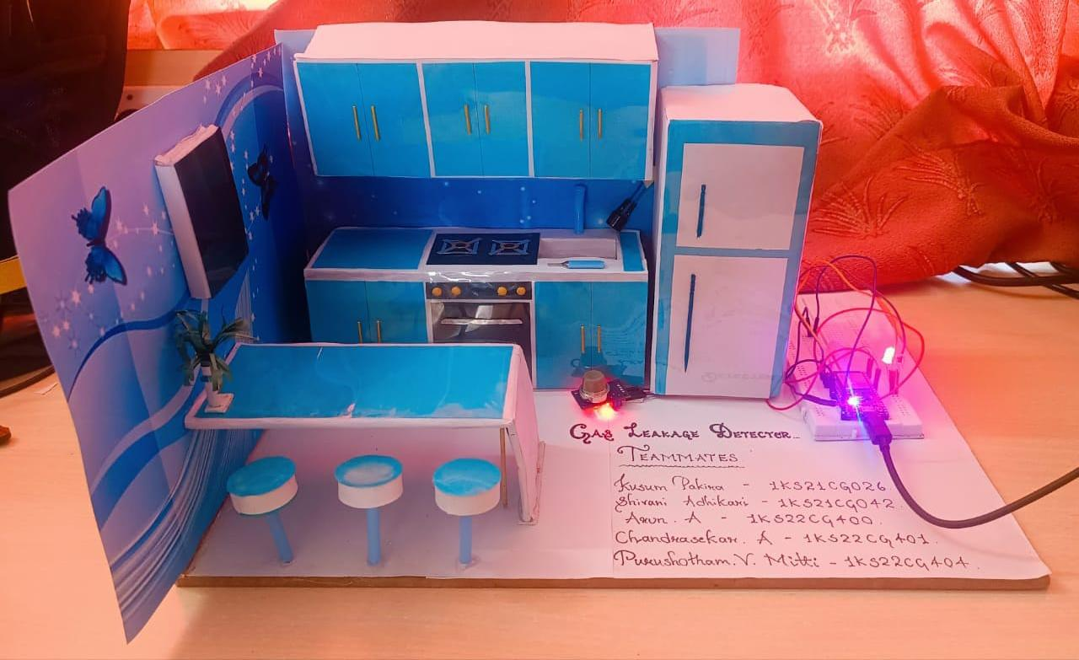
INTERNSHIP OBJECTIVE
Early Detection Safety Assurance Alarm System Continuous Monitoring Accuracy and Sensitivity Automatic Shutoff Data Logging Remote Notification Compliance with Standards User-Friendly Interface

Slide 5
INTERNSHIP TASKS
A gas leakage detector performs several critical tasks. Its primary function is to detect the presence of potentially hazardous gases such as natural gas, propane, and carbon monoxide in the air.
Upon detecting these gases, it immediately alerts occupants through audible alarms, visual indicators, or connected smart devices, enabling prompt action to mitigate risks.
The detector continuously monitors the environment for gas leaks, ensuring constant protection. In some advanced systems, it can also automatically shut off the gas supply to prevent escalation of the leak into a more dangerous situation.
This proactive approach helps in preventing accidents, protecting health, and preserving property.

Slide 6
Project : Gas Leakage Detection
Gas leakage detection addresses a significant problem faced by humans: the risk of undetected gas leaks.
Without proper detection, leaks of gases such as natural gas, propane, and carbon monoxide can lead to severe consequences, including explosions, fires, and toxic poisoning.
These gases are often colorless and odorless, making them difficult to detect without specialized equipment.
The lack of early detection can result in delayed responses, putting lives at risk and causing extensive property damage.
Therefore, the absence of effective gas leakage detection systems presents a serious safety hazard in both residential and commercial settings.

Slide 7
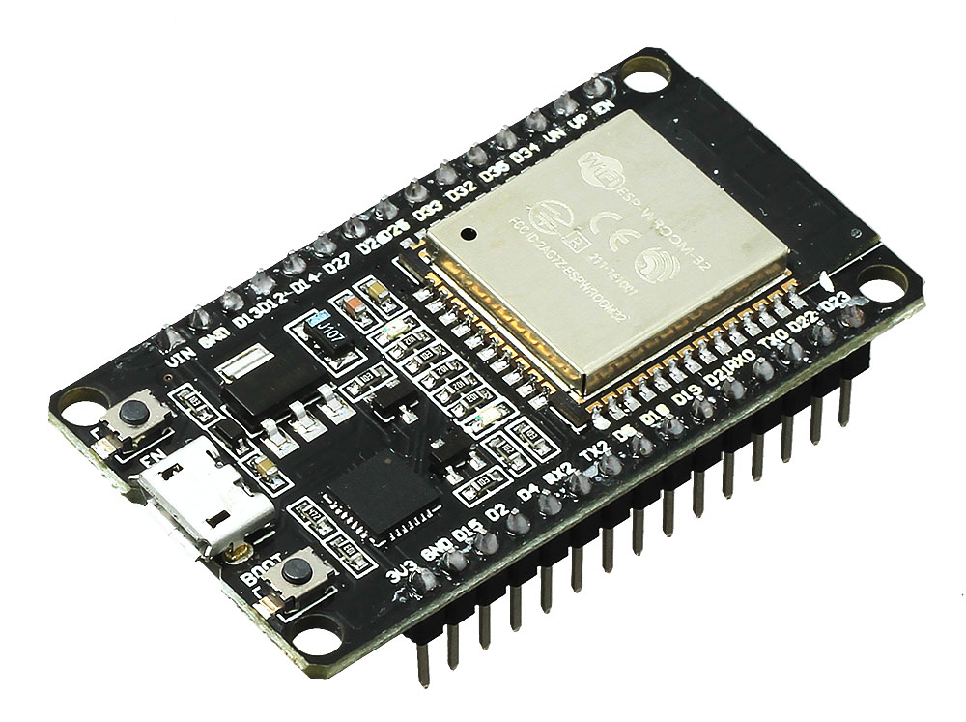
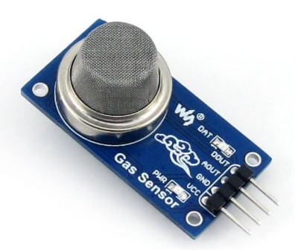
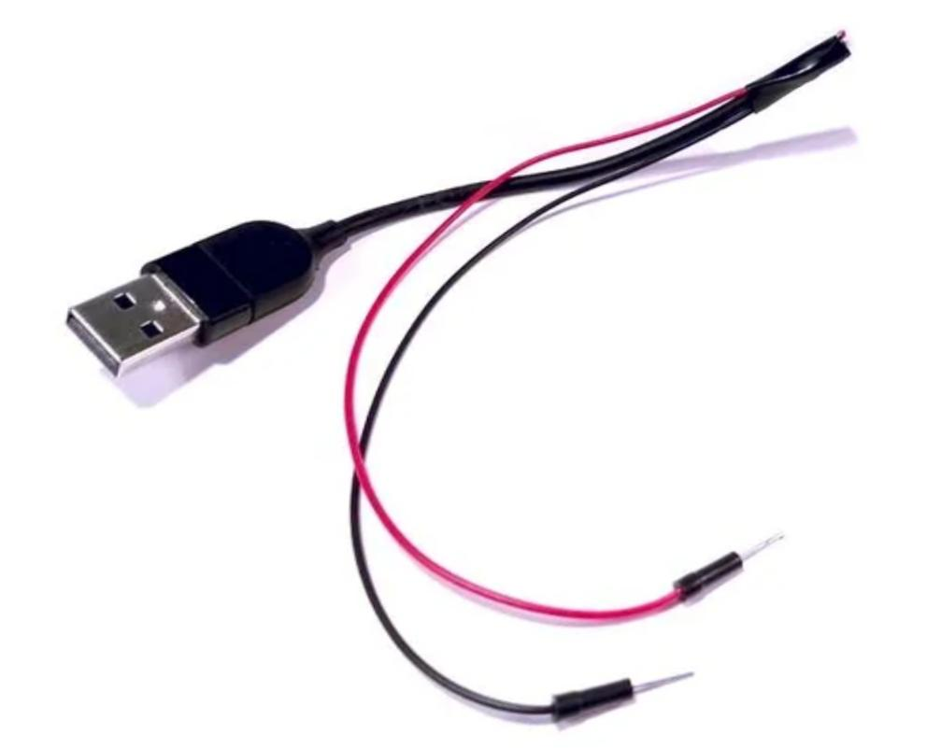
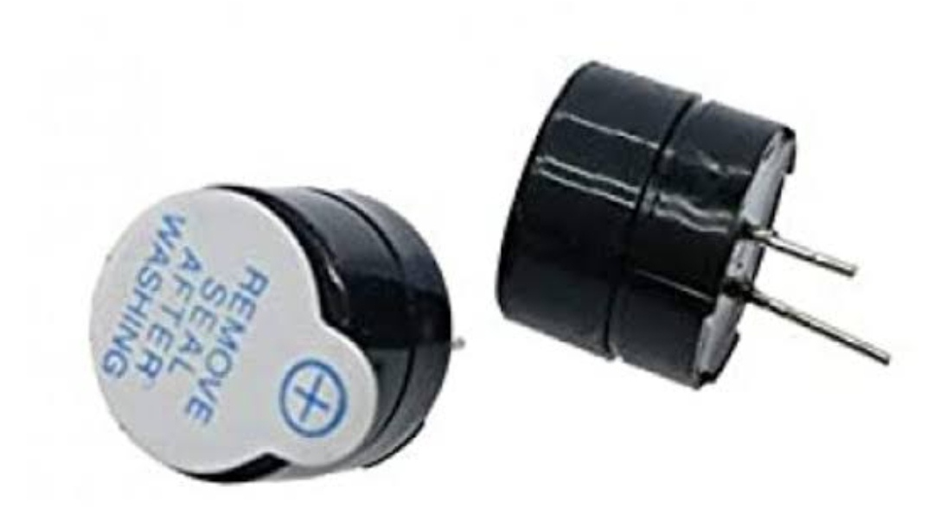
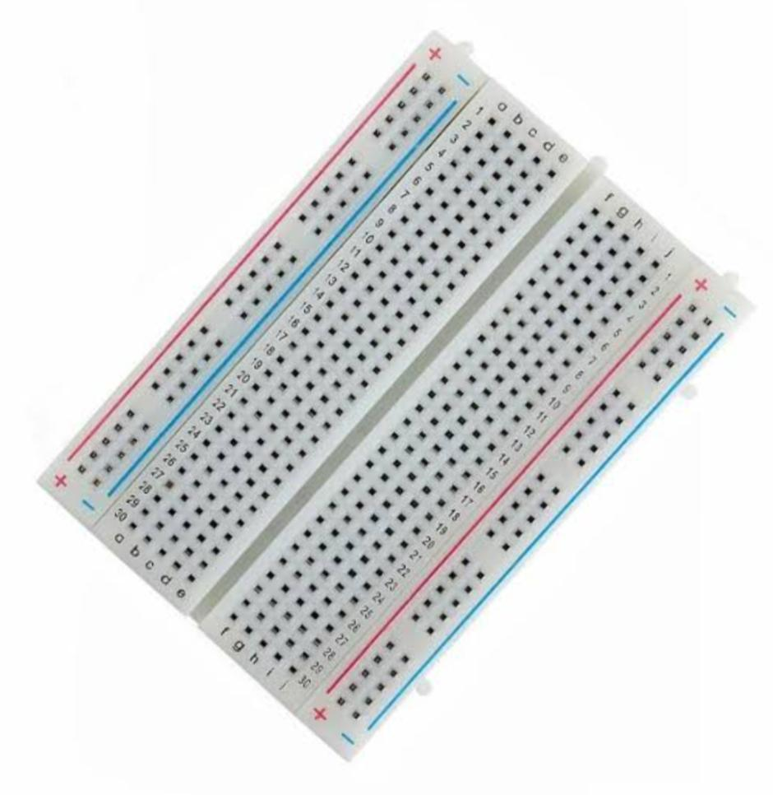
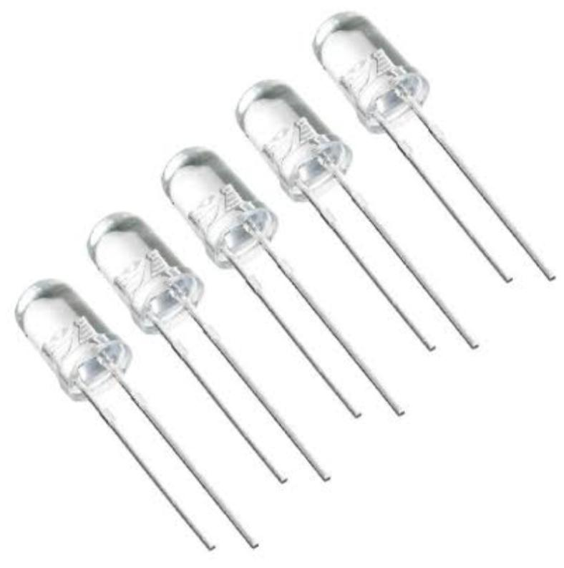
HARDWARE REQUIREMENTS
ESP32 Development Board Gas Sensor Buzzer LED Bulb Power Supply Connecting Wires Breadboard PCB (Printed Circuit Board) USB Cable

Slide 8
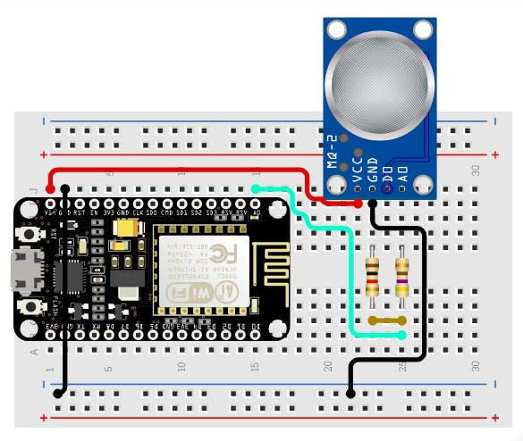
Software requirements
Thonny ESP32 Board Support ESP32 Libraries Cloud Service Account Wi-Fi Configuration Notification Configuration Safety Considerations in Code Continuous Monitoring Loop

Slide 9
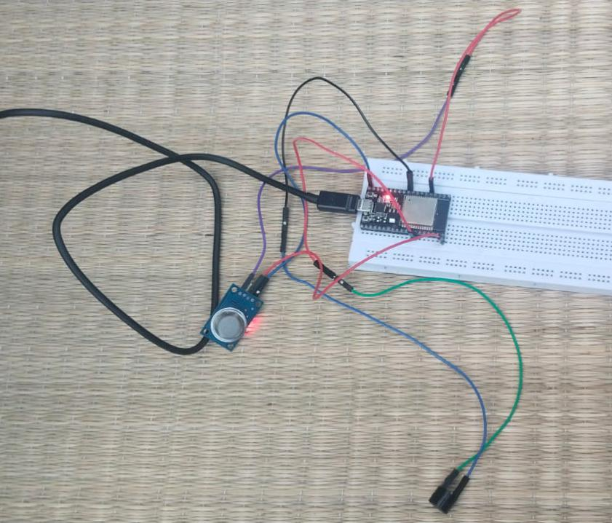
Connection Required
Esp 32 3 ground pins 2 VCC pin 5v 3v
Esp 32 Ground pin connected to Gas sensor Ground pin
Gas sensor vss pin connected to ESP 32 vcc (5v )
Gas sensor A0 pin connected to ESP32 Gpio pin (X)
Gas sensor D0 pin empty
Buzzer have 2 connection pins long and short pin
Long pin Gpio pin,short pin Ground pin
Long pin is connected to Gpio pin ESp32
Short pin is connected to ground pin
Led bulb pins one is positive , another one negetive

Slide 10
Working:
1. Programming the ESP32: Install the necessary libraries for the ESP32 and the gas sensor. Write a program to initialize the sensor, read its analog output, and process the data. Set a threshold value for the gas concentration. If the sensor’s reading exceeds this value, it indicates a gas leak.
2. Wi-Fi Notifications: Configure the ESP32 to connect to a Wi-Fi network. Set up a web server or use MQTT to send alerts to a mobile app or a monitoring system. Example: Sending an email or SMS via an online service like IFTTT.

Slide 11
(contd.)
3. Testing and Calibration: Test the detector in a controlled environment with known gas concentrations. Calibrate the sensor by adjusting the threshold value for accurate detection.
4. Deployment: Install the detector in the desired location. Ensure it is positioned where gas leaks are likely to occur and can be detected early. Regularly maintain and test the system to ensure ongoing reliability.
This setup provides a cost-effective and efficient gas leakage detection system using the ESP32, with the added benefit of connectivity for remote monitoring and alerts.

Slide 12
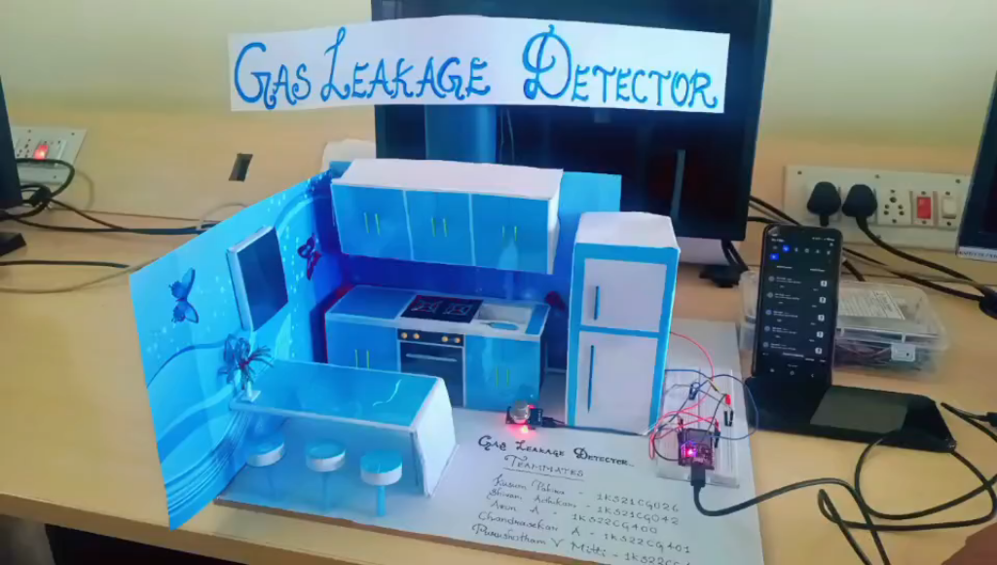

Slide 13
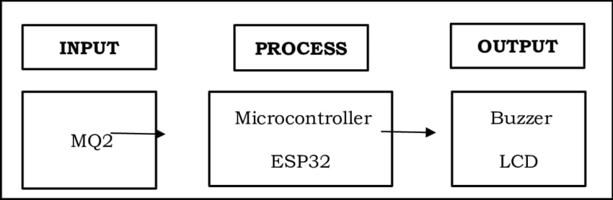
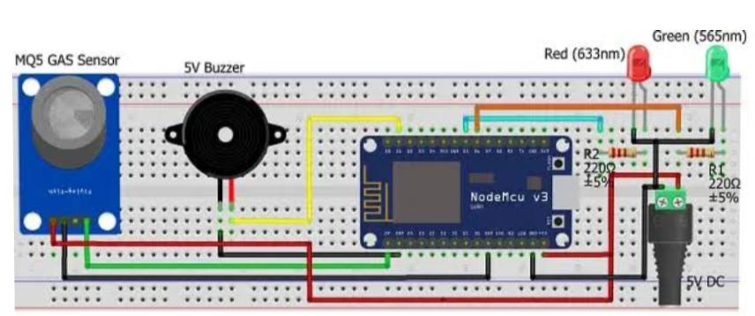
Block Diagram

Slide 14
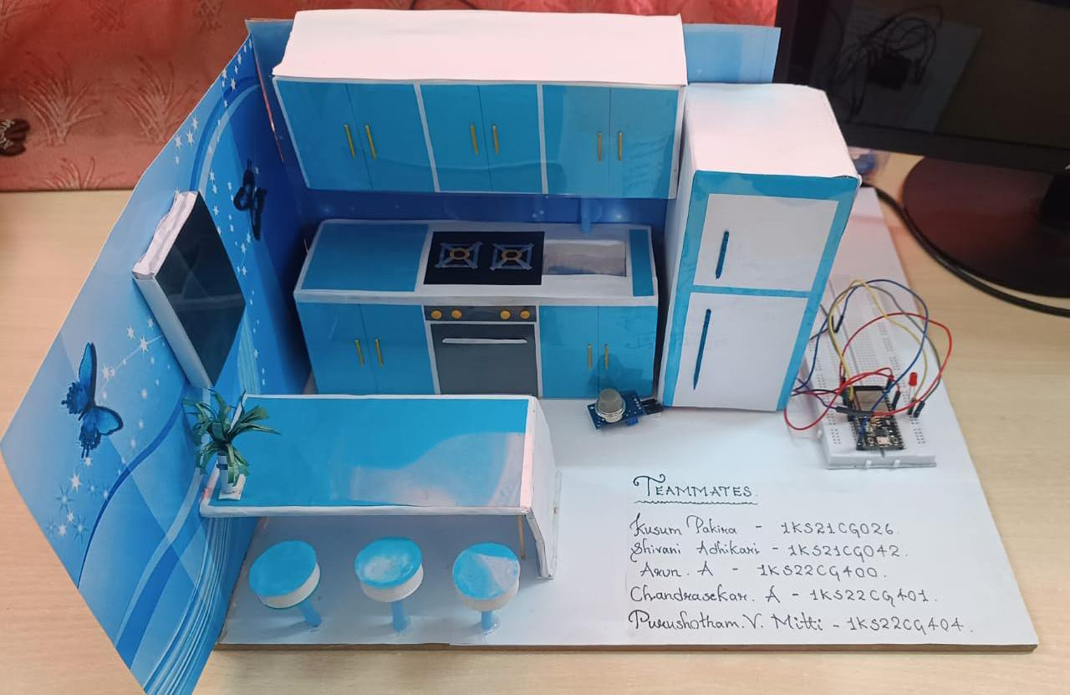
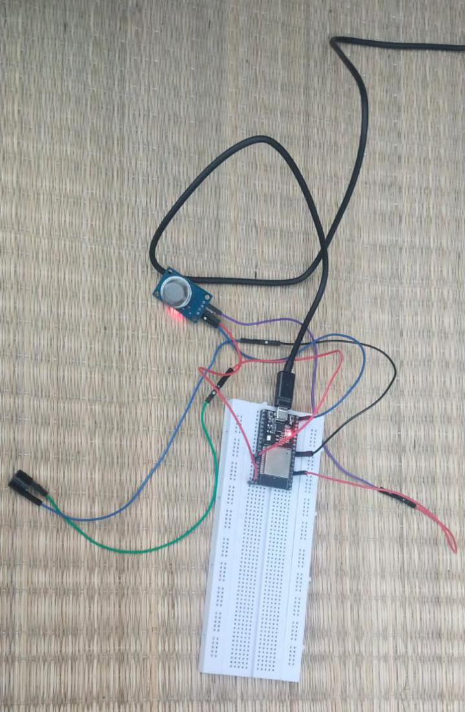
Circuit Setup & Snapshot:

Slide 15
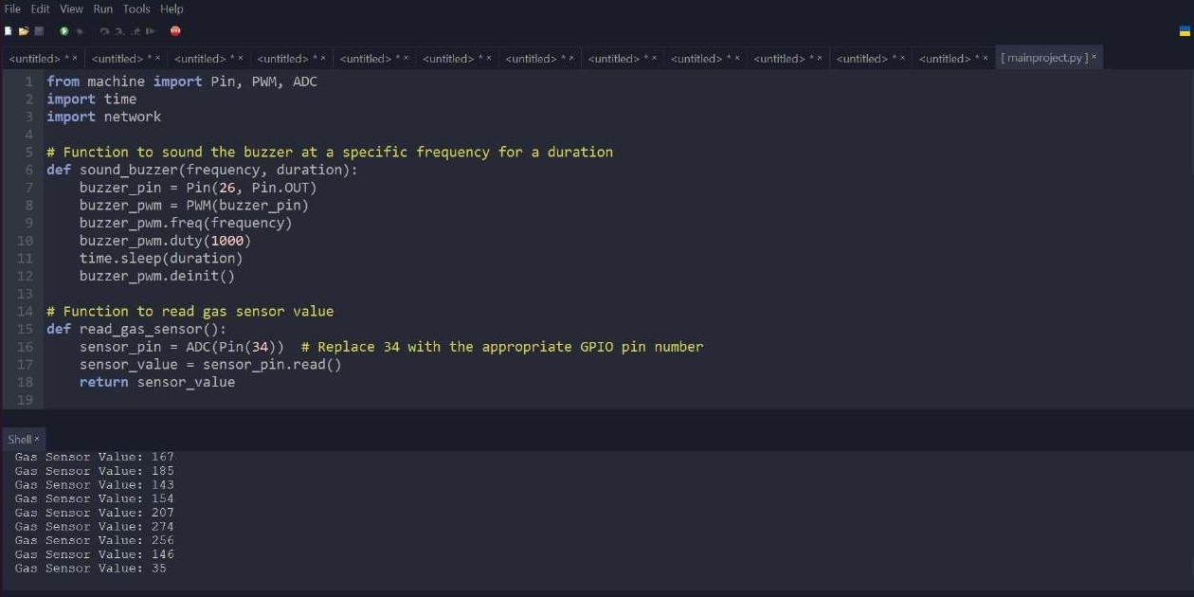
2.THONNY IDE OUTPUT

Slide 16
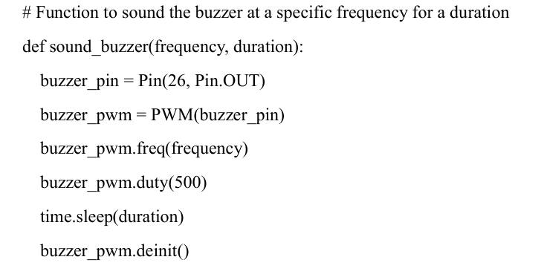
CODE SNIPPET

Slide 17
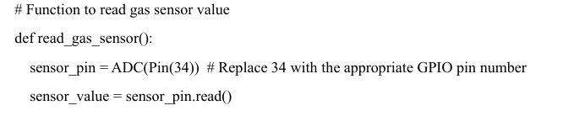
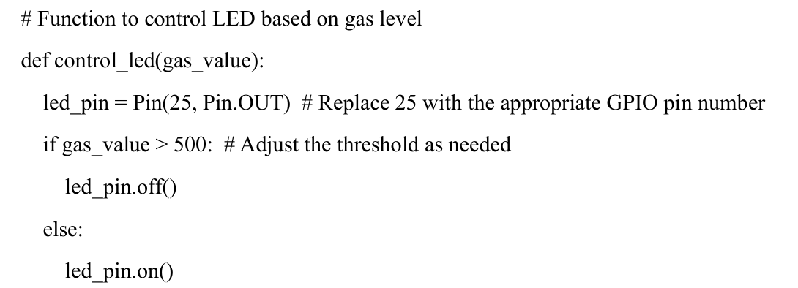

Slide 18
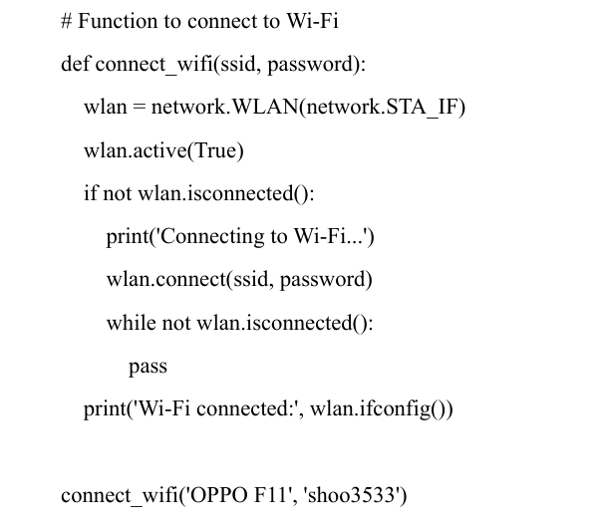

Slide 19

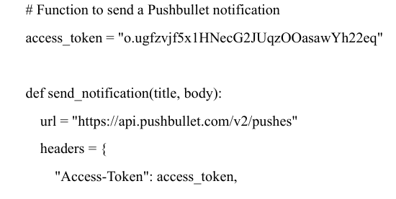
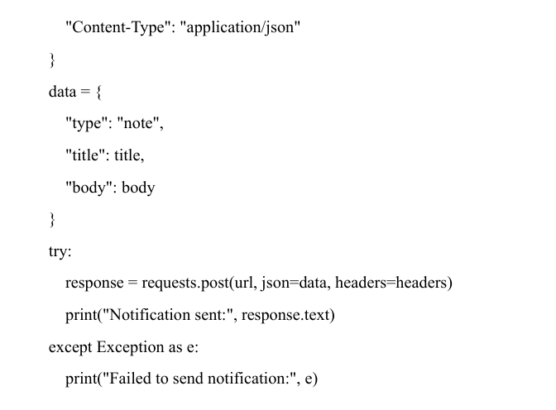
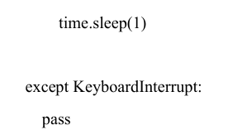

Slide 20
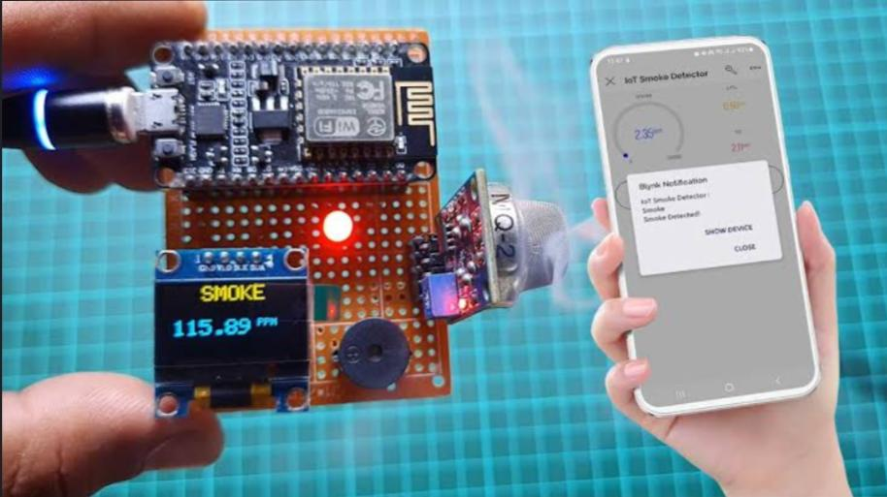
INTERNSHIP IMPACT
1.Results Summary
Enhanced Safety Health Protection Environmental Protection Cost Savings Regulatory Compliance Peace of Mind Automation Integration Reduced Downtime Insurance Benefits Technological Advancements

Slide 21
2.Challenges Faced
Gas leakage detectors face significant challenges in balancing sensitivity and selectivity. Detecting small leaks requires high sensitivity, but this can lead to false alarms if the detector cannot distinguish between hazardous gases and harmless substances. Environmental factors such as humidity, temperature variations, and dust further complicate this balance by potentially causing inaccurate readings or reduced sensitivity.
Another major challenge is ensuring continuous and reliable operation, especially in remote or hazardous locations where power supply and energy efficiency are critical. High-quality gas detectors can be expensive, limiting their accessibility for smaller businesses and low-income households.

Slide 22
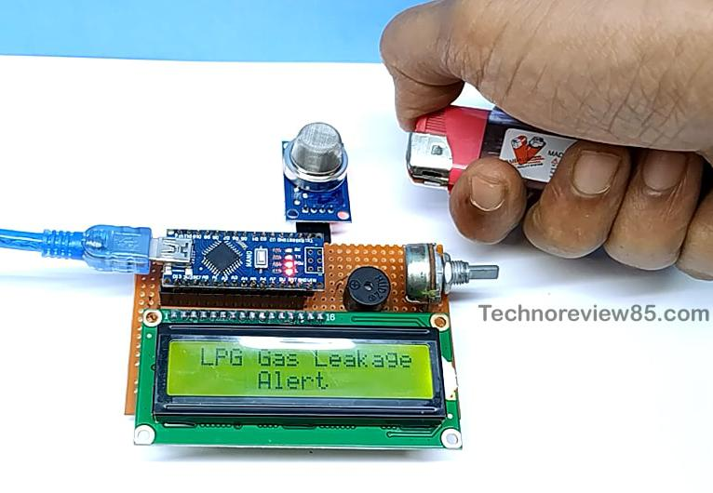

3.Future Scope
Enhanced Sensitivity and Accuracy Wireless and IoT Integration AI and Machine Learning Energy Efficiency Integration with Building Management Systems Portable and Wearable Detectors Regulatory and Compliance Enhancements Environmental Impact Monitoring Cost Reduction and Accessibility Multi-Gas Detection Capabilities

Slide 23
CONCLUSION
The Gas Detection Monitoring System using the ESP32 microcontroller represents a cutting-edge solution in the realm of safety technology.
By seamlessly combining accurate gas detection, local alerts, and remote notifications, the system not only mitigates the immediate risks associated with gas leaks but also sets the stage for future advancements in safety protocols.
As we strive for safer living and working environments, this system stands as a testament to the potential of IoT-driven solutions in ensuring the well-being of individuals and communities.
The Gas Detection Monitoring System is not merely a technological innovation; it is a commitment to a safer, more secure future.

Slide 24
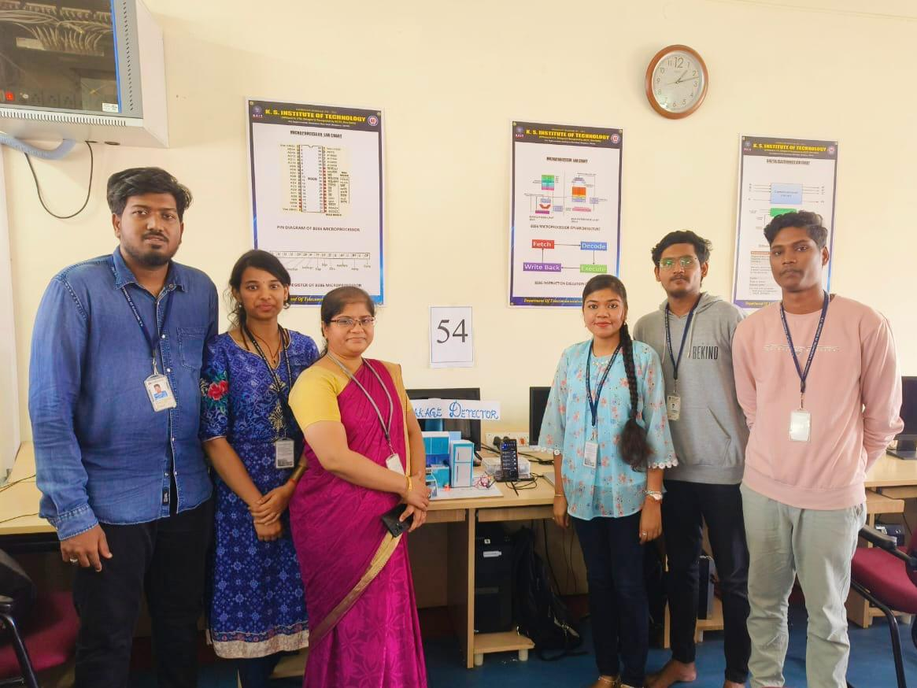

Espressif Systems. (n.d.). ESP32 Resources. https://www.espressif.com/en/products/socs/esp32/resources Pushbullet. (n.d.). Pushbullet API Documentation. https://docs.pushbullet.com/ MQ Gas Sensors Datasheet. (Example: MQ-2) – Gas Sensor Manufacturer’s Website or Distributor. Youtube videos https://www.youtube.com/watch?v=Yz1ePCLfYGM&t=162s https://www.youtube.com/watch?v=dqzcyxSuObk&t=14s
​REFERENCES

Slide 25

THANK YOU

